Slide 1
Statistical Methodology for
Software Engineers
Hadas Lapid, PhD
Statistics for Software Engineers
© Hadas Lapid
Notes:
An Introduction to Statistical Methods and Data Analysis 7th Edition
R. Lyman Ott Michael Longnecker
Chap. 1.2, page 5
------------------------------
על הקורס
חשיבות סטטיסטיקה
כללי
ביוסטטיסטיקה, ניהול עסקי (BI), הנדסה (ניתוח ביצועים)
מדעי המחשב
Big Data, Data Science, Machine Learning, Analytics
עלי
בוגר תואר 2 בטכנולוגיה, הטכניון עם התמחות בראיה ממוחשבת, אלגוריתמים, מערכות חישה
ניסיון בחברות טכנולוגיות, כמהנדס, מנהל אלגוריתמים ויזם טכנולוגי.
מנחה ותיק של פרויקטי גמר בהנדסת תוכנה וחשמל
למידה, טיפים - חזרות דיאלקטיות

Slide 2
Course Syllabus
• Statistical distributions
• Hypothesis testing
• Chisquare test for goodness of fit
• Extreme value distribution and its role in sequence analysis
• Multiple hypothesis testing
• Analysis of contingency tables
• Two-sample t-test
• Analysis of variance
• Non-parametric tests
• Correlation tests
• Linear regression
Statistics for Software Engineers
© Hadas Lapid
Notes:
הערות על הקורס
המטרה לאפשר התמודדות עם מידע טבעי (מדוד ולא רק מוקלד..) רציף (לא דיסקרטי..), לא מדויק, וחלקי...
דגש על הבנת המחשבה הסטטיסטית
פחות על הרקע המתמטי
שאלות העדפה לתקשורת

Slide 3
Course Requirements
4 HW Assignments, 20%
Exam, 80%
Success guaranteed if
Review class materials before each lecture
Practice and freely explore R software
Resources
All course materials on Moodle
“An Introduction to Statistical Methods and Data Analysis” by R. Lyman Ott and Michael Longnecker (on moodle)
Introduction to Statistics and Data Analysis _ With Exercises, Solutions and Applications in R - Heumann · Schomaker
R Software: https://rstudio.com/products/rstudio/download/#download
Web-textbook: http://www.statsoft.com/Textbook
Statistics for Software Engineers
© Hadas Lapid

Slide 4
Contents Today
• Variables
- types
- Basic concepts
• Distributions
- Binomial Distribution
- Poisson Distribution
- Normal Distribution
- Standardized Normal Density function
• Data example
Statistics for Software Engineers
© Hadas Lapid

Slide 5
Why do we need statistics?
Typical Problems:
Data variability
Repeated measurements may yield different results
Statistical Solutions:
Provide predictions of outcome
Draw conclusions about data variables (inverse problem)
Related Subjects:
Probability (direct problem)
Applications: Business analytics (BI), Biology (Biostatistics),
Machine learning (predicting)
Operations research (optimization of complex systems)
Statistics for Software Engineers
© Hadas Lapid
Notes:
למה צריך סטטיסטיקה?
מידע מגשישים פיזיקליים הוא סטטיסטי/ רועש
-----------------------------------------------------
מקצועות קשורים בסטטיסטיקה
https://en.wikipedia.org/wiki/List_of_fields_of_application_of_statistics
Probability –טוב לאנשי פיתוח שיש להם מודל למוצר שלהם והם זקוקים לתאר את ההתנהגות שלו בשטח
Business analytics is a rapidly developing business process that applies statistical methods to data sets (often very large) to develop new insights and understanding of business performance & opportunities
Machine learning is the subfield of computer science that formulates algorithms in order to make predictions from data. Predicts single item (object) behavior
Operations research (or operational research) is an interdisciplinary branch of applied mathematics and formal science that uses methods such as mathematical modeling, statistics, and algorithms to arrive at optimal or near optimal solutions to complex problems.
Data Mineing
מה ההבדל בין סטטיסטיקה והסתברות?
http://www.johnkerl.org/doc/prbstat0/prbstat.html
Probability versus Statistics
In probability
Models, Rules → data: Given the rules, describe the likelihoods of various events occurring.
Probability is about prediction — looking forward.
Probability is mathematics.
The statistician turns this around:
Model, Rules ← data: Given only the data, try to guess what the rules were. That is, some probability model controlled what data came out, and the best we can do is guess — or approximate — what that model was. We might guess wrong; we might refine our guess as we get more data.
Statistics is about Inference - looking backward.
Statistics is an art. It uses mathematical methods, but it is more than math.
-----------------------------------------------------
מה ההבדל בין סטטיסטיקה ולמידת מכונה?
Statistics versus machine learning
https://www.nature.com/articles/nmeth.4642
Statistics: Sample → Infer about Population mean, std
ML: Sample → Predicts/ Classify Item, Object, one trail
Statistics draws population inferences from a sample
machine learning finds generalizable predictive patterns.
Machine Learning - Modeling/ parsimony (חסכנות)
Parsimony (simplest model that explains the samples)
“The major difference between machine learning and statistics is their purpose.
Statistical models are designed for inference about the relationships between variables.” ... Statistics is the mathematical study of data "דע מהיכן אתה דטה ולהיכן אתה הולך"
Machine learning models are designed to make the most accurate predictions possible.
Week 9 Machine Learning versus classical statistics
https://www.youtube.com/watch?v=U0XIBBuJal4
https://en.wikipedia.org/wiki/William_Sealy_Gosset
-----------------------------------------------------------------------------
William Sealy Gosset (1876–1937) was a 19th- math and chemistry. The latter expertise led the Guinness Brewery in century uber-geek in both Dublin, Ireland, to hire Gosset after college, but the former made Gosset a household name in the world of statistics. As a forward-looking business, the Guinness brewery was alert for ways of making batches of beer more consistent in quality. Gosset stepped in and developed what we now refer to as “smallsample statistical techniques”—ways of generalizing from the results of a relatively few observations (Lehmann, 2012). Brewing a batch of beer takes time, and high-quality ingredients are not cheap, so in order to draw conclusions from experimental methods applied to just a few batches, Gosset had to figure out the role of chance in determining how a batch of beer had turned out. The brewery frowned upon academic publications, so Gosset had to publish his results under the modest pseudonym “Student.” If you ever hear someone discussing the “Student’s t-test,” that is where the name came from. The Student’s t-test allows us to compare two groups on some measurement. This process sounds simple, but has some complications hidden in it. Let’s consider an example as a way of illustrating both the simplicity and the complexity. Perhaps we want to ask the question of whether “ale yeast” or “lager yeast” produces the higher alcohol content in a batch of beer. Obviously, we need to brew at least one batch of each type, but every brewer knows that many factors influence the composition of a batch, so we should really brew several batches with lager yeast and several batches with ale yeast. Let’s brew five batches of each type. When we are done we can average the measurements of alcohol content across the five batches made with lager yeast and do the same across the five batches made with ale yeast.
-----------------------------------------------------------------------------

Slide 6
What are variables?
• Objective/subjective measures that can be monitored, controlled or manipulated.
• Variables differ in the quantity of measurable information their scale provides
Dependent vs. Independent variables
• Independent variables – inputs, explanatory, manipulated in the research (e.g. gender)
• Dependent variables – output, response only measured/monitored (e.g. white cell blood count)
Statistics for Software Engineers
© Hadas Lapid
Notes:
2.5 Designs for experimental Studies , page 38
In Factor experiments we examine the effect of
two or more independent (input, or explanatory) variables x,
on a dependent (output, response) variable y.
11.1 Correlation page 555
regression analysis - is to obtain a model for the functional relationship between
a response variable (often referred to as the dependent variable)
and one or more explanatory variables (often referred to as the independent variables).
Dependent and independent variables
https://en.wikipedia.org/wiki/Dependent_and_independent_variables
Dependent Variables – car max speed and engine volume (CC)
Independent Variables – car max speed and color

Slide 7
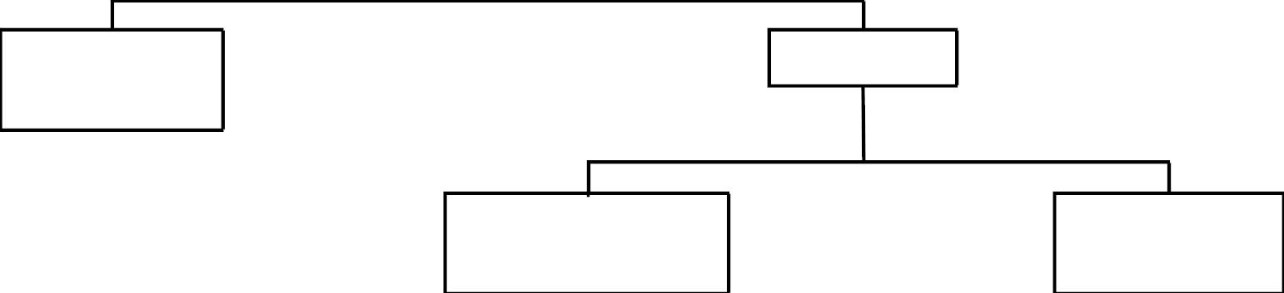
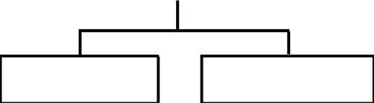
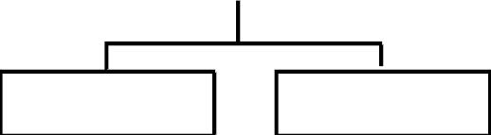
Variables Classification
Categorical
Nominal
Numerical
Mathematical
classification
Statistical
classification
Discrete
Continuous
Interval
Ordinal
Statistics for Software Engineers
© Hadas Lapid
Notes:
Categorial data: a category with 2 or more categories (male, female..)
Ordinal data: clear order (low, medium and high)
a kind of categorical data with a set order or scale to it. For example, ordinal data is said to have been collected when a responder inputs his/her financial happiness level on a scale of 1-10. In ordinal data, there is no standard scale on which the differrence in each score is measured
Interval data, (e.g. histogram cell) also called an integer, is defined as a data type which is measured along a scale, in which each point is placed at equal distance from one another. Interval data always appears in the form of numbers or numerical values where the distance between the two points is standardized and equal.

Slide 8

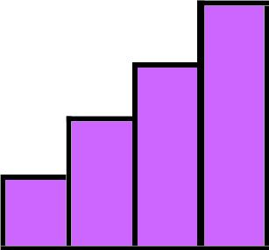
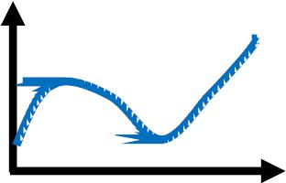
Nominal (Categorical) Variables
Enable qualitative classification
i.e., whether an item belongs to a distinct category
e.g., city, gender, color
A B
B
Discrete Variables
Enable order ranking
i.e., whether an item has more or less of the measured quality
e.g., Olympic rank, grades rank, disease severity level
D
C
B
A
Continuous Variables
Quantitative measurement
i.e., how much of the measured characteristic the item displays
e.g., height, weight, temperature

Slide 9
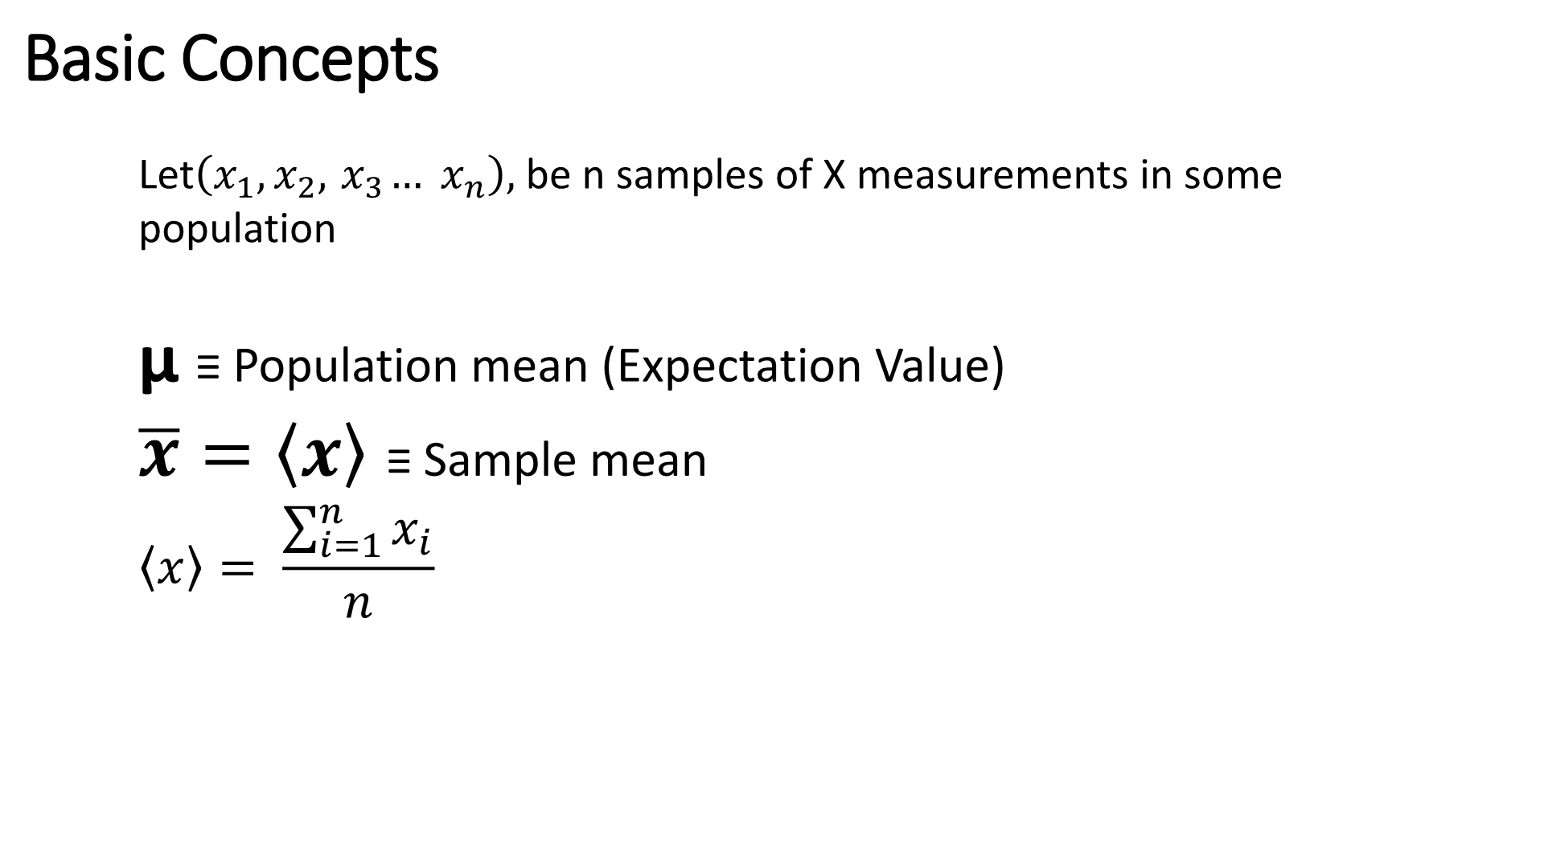

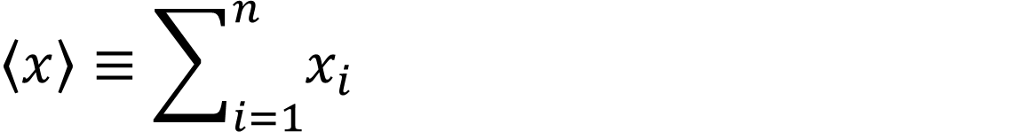
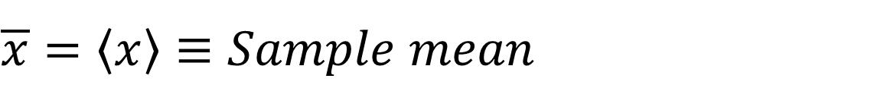
Basic Concepts
Let
population
, be n samples of X measurements in some
ഥ ,ഥ ,ഥ … ഥ_{ഥ}
1 2 3
μ ≡ Population mean (Expectation Value)
$$\overline{x}=\left\langle x\right\rangle ≡Sample mean$$
$$\left\langle x\right\rangle ≡\sum_{i=1}^{n}{x_{i}}$$
Notes:
אוכלוסיה (population)
מצביעים לכנסת (לא בכל העולם...)
נשים בהריון (לא כל הנשים)
מדגם (sample) - דגימה מתוכננת (או לא..) שמהווה חלק קטן מהאוכלוסיה

Slide 10
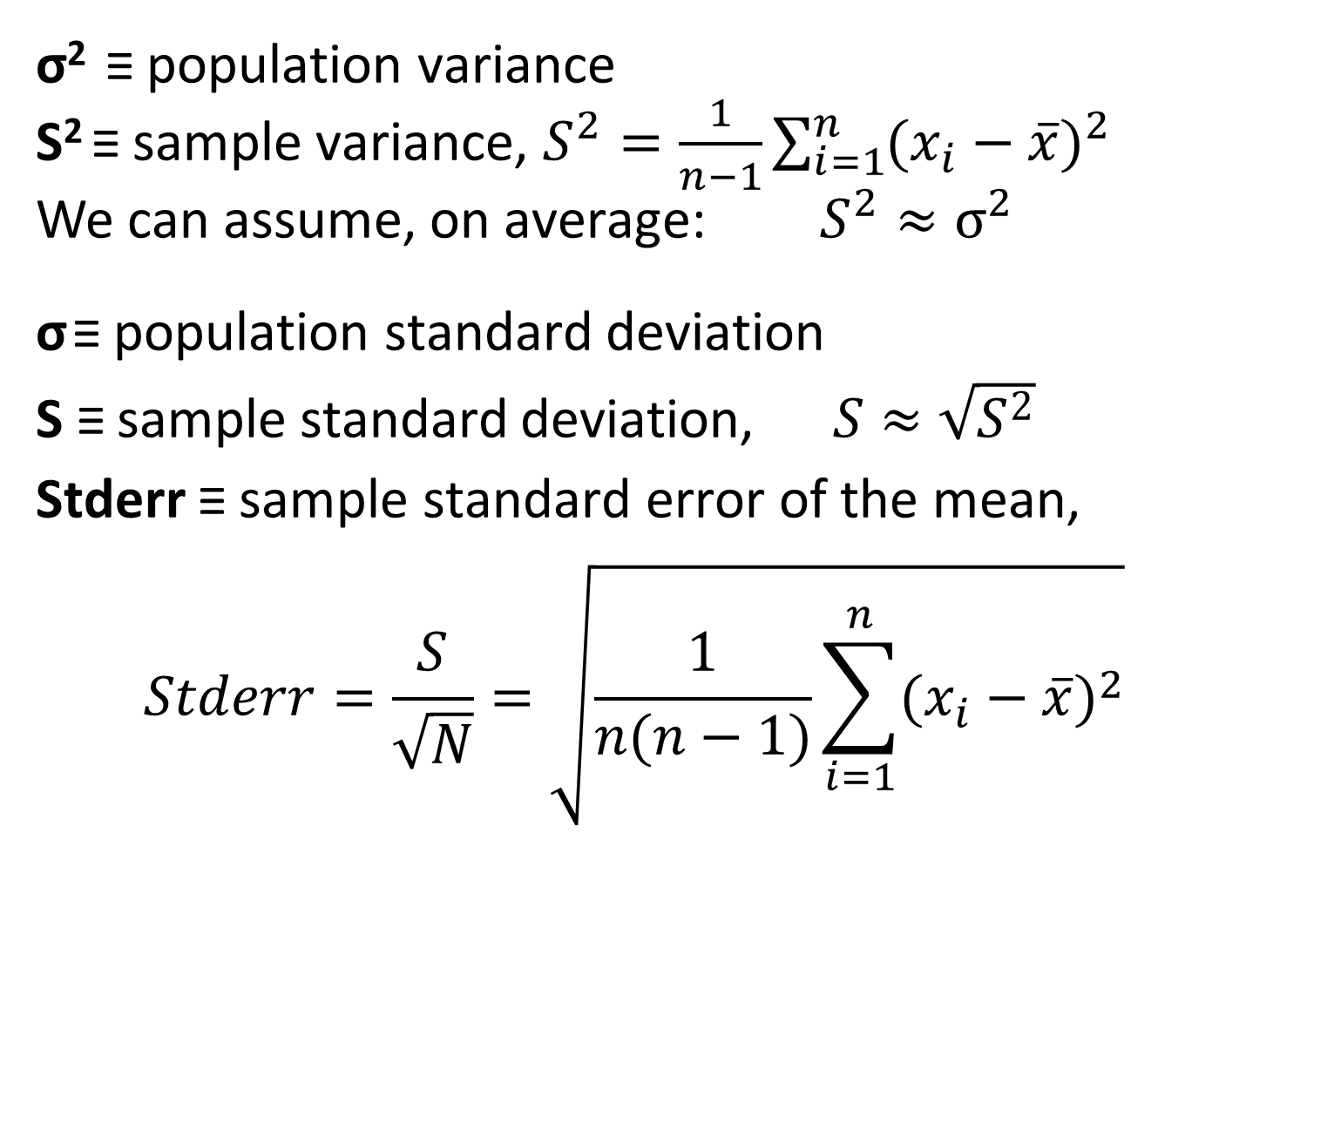
Basic Concepts
σ² ≡ population variance
S² ≡ sample variance, $S^{2}=\frac{1}{n−1}\sum_{i=1}^{n}{{(x_{i}−\overline{x})}^{2}}$
We can assume, on average: $S^{2}≈σ^{2}$
σ ≡ population standard deviation
S ≡ sample standard deviation, $S≈\sqrt{S^{2}}$
Stderr ≡ sample standard error of the mean,
$$Stderr=\frac{S}{\sqrt{N}}=\sqrt{\frac{1}{n(n−1)}\sum_{i=1}^{n}{{(x_{i}−\overline{x})}^{2}}}$$
Notes:
https://math.stackexchange.com/questions/906905/derivation-of-standard-error-of-mean
$${Stderr}^{2}=\sum_{i=1}^{n}{{(s_{i}}^{2}{(\frac{∂\overline{x}}{∂x_{i}})}^{2}})$$
$$\left\{\begin{matrix}{s_{i}}^{2}=s^{2} \\ \frac{∂\overline{x}}{∂x_{i}}=\frac{∂}{∂x_{i}}(\frac{1}{n}\sum_{i=1}^{n}{{x_{i}}^{2}}\text{)=}\frac{1}{n} \end{matrix}\right.$$
${Stderr}^{2}=\sum_{i=1}^{n}{(s^{2}{(\frac{1}{n})}^{2}}$)=$s^{2}\frac{n}{n^{2}}=\frac{s^{2}}{n}$
$$Stderr=\frac{s}{\sqrt{n}}$$
https://www.planetofbits.com/statistics/standard-error-variance-of-mean-derivation/

Slide 11
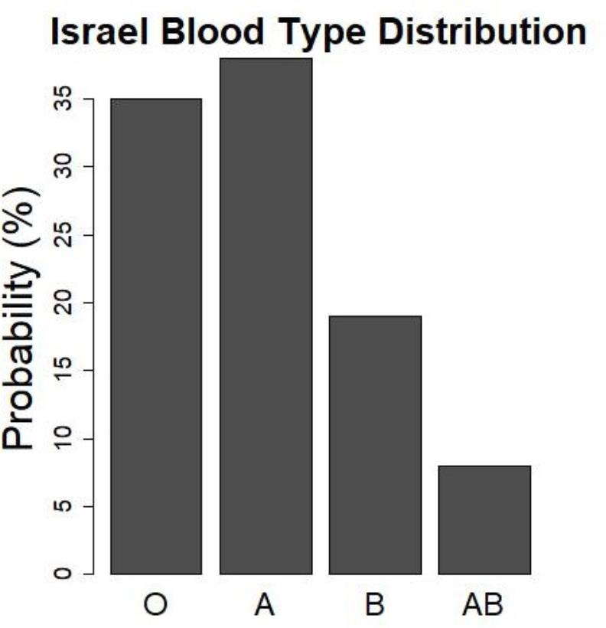
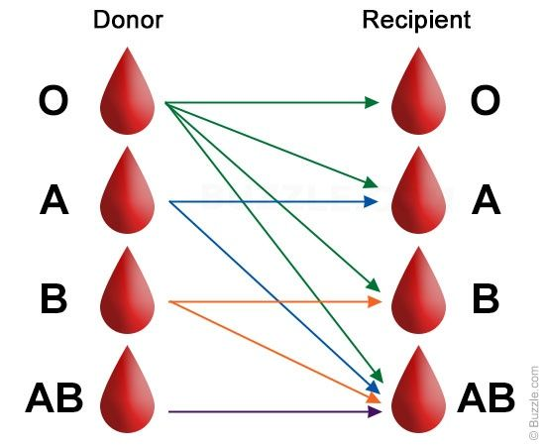
Distributions
Categorical Variable Distribution
Statistics for Software Engineers
© Hadas Lapid
Notes:
למשתנים אקראיים יש הסתברות להיות בערכים שונים בכל מדידה
למשתנים קטגוריים, הסתברות שונה לכל קטגוריה – סכ"ה ההסתברויות 1
הסתברות כללית:
O - 35
A - 39
B - 19
AB- 7
TYPE AB O+A+B+AB = 100%
TYPE A O+A = 74%
TYPE B O+B = 54%
TYPE O O = 35%

Slide 12
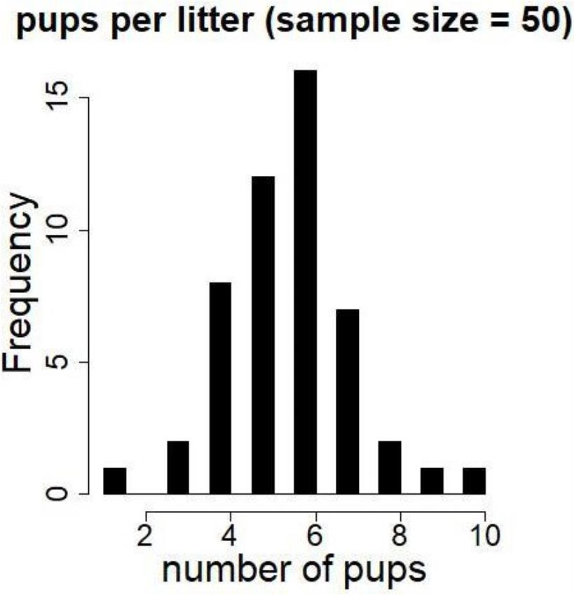
Discrete Variable Distribution
Statistics for Software Engineers
© Hadas Lapid
Notes:
למשתנים אקראיים דיסקרטיים, כגון תאים של הסטוגרמה (מספרים שלמים למשל) הסברות סופית

Slide 13
Binomial Variables
• Binomial variable is a measured outcome of an
experiment, which can be either Success (True) or
Failure (False) (Bernoulli trial).
ρ = Probability of Success (roh)
q = 1-ρ = Probability of Failure
Statistics for Software Engineers
© Hadas Lapid

Slide 14
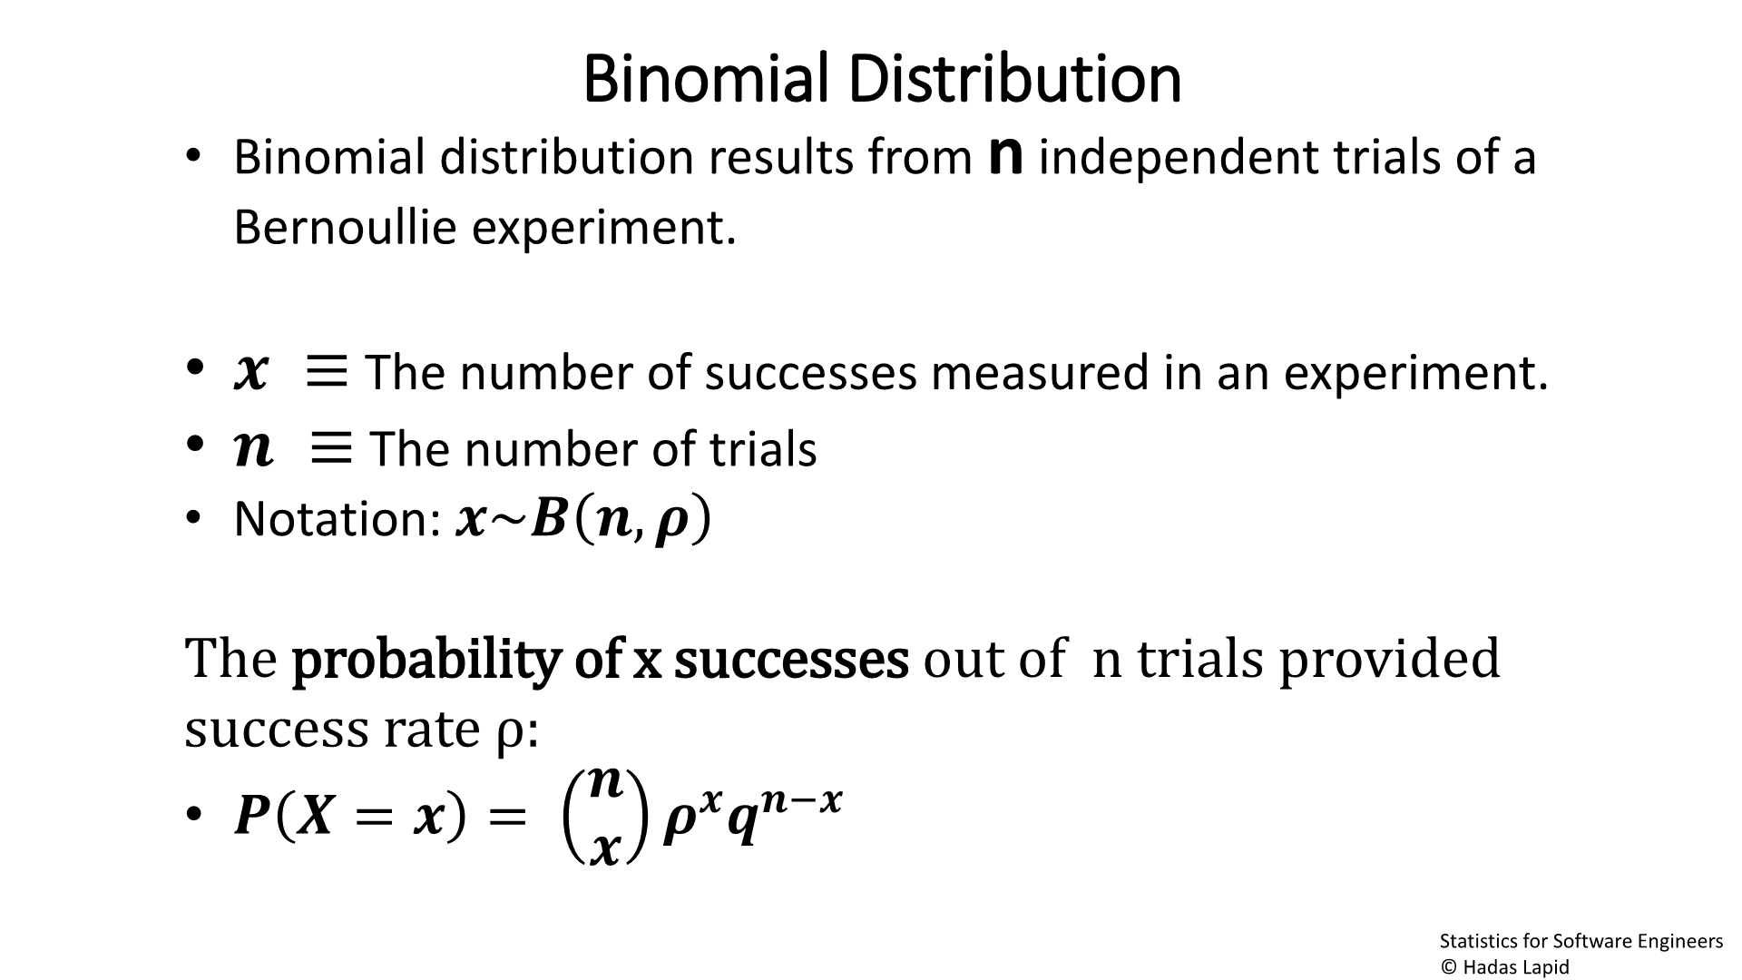



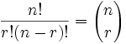
Binomial Distribution
• Binomial distribution results from n independent trials of a
Bernoullie experiment.
• ഥ ≡ The number of successes measured in an experiment.
• ഥ ≡ The number of trials
• Notation: ഥ~ഥ
ഥ,ഥ
The probability of x successes out of n trials
provided success rate ρ:
ഥ
ഥ
ഥ ഥ−ഥ
• ഥ
ഥ = ഥ = ഥ ഥ
Statistics for Software Engineers
© Hadas Lapid
Notes:
In general, if the random variable X follows the binomial distribution with parameters n ∈ ℕ and p ∈ [0,1],
we write X ~ B(n, p). The probability of getting exactly k successes in n independent Bernoulli trials is given by the probability mass function:
f(k,n,p) = Pr(k;n,p) = Pr(X=k) = {n|k}*p^{k}*(1-p)^{n-k}
for k = 0, 1, 2, ..., n, where
{n|k} = n! / (k! / (n−k)!)
is the binomial coefficient, hence the name of the distribution.
The formula can be understood as follows.
k successes occur with probability p^{k} and n − k failures occur with probability (1 − p)^{n − k}.
However, the k successes can occur anywhere among the n trials, and there are {n|k} different ways of distributing k successes in a sequence of n trials.
----------------------------------
When the order doesn't matter, it is a Combination.
When the order does matter it is a Permutation.
https://www.mathsisfun.com/combinatorics/combinations-permutations.html
Combinations (קומבינציות)
C(n,x) = {n|x) = n! / (x! / (n−x)!)

Slide 15
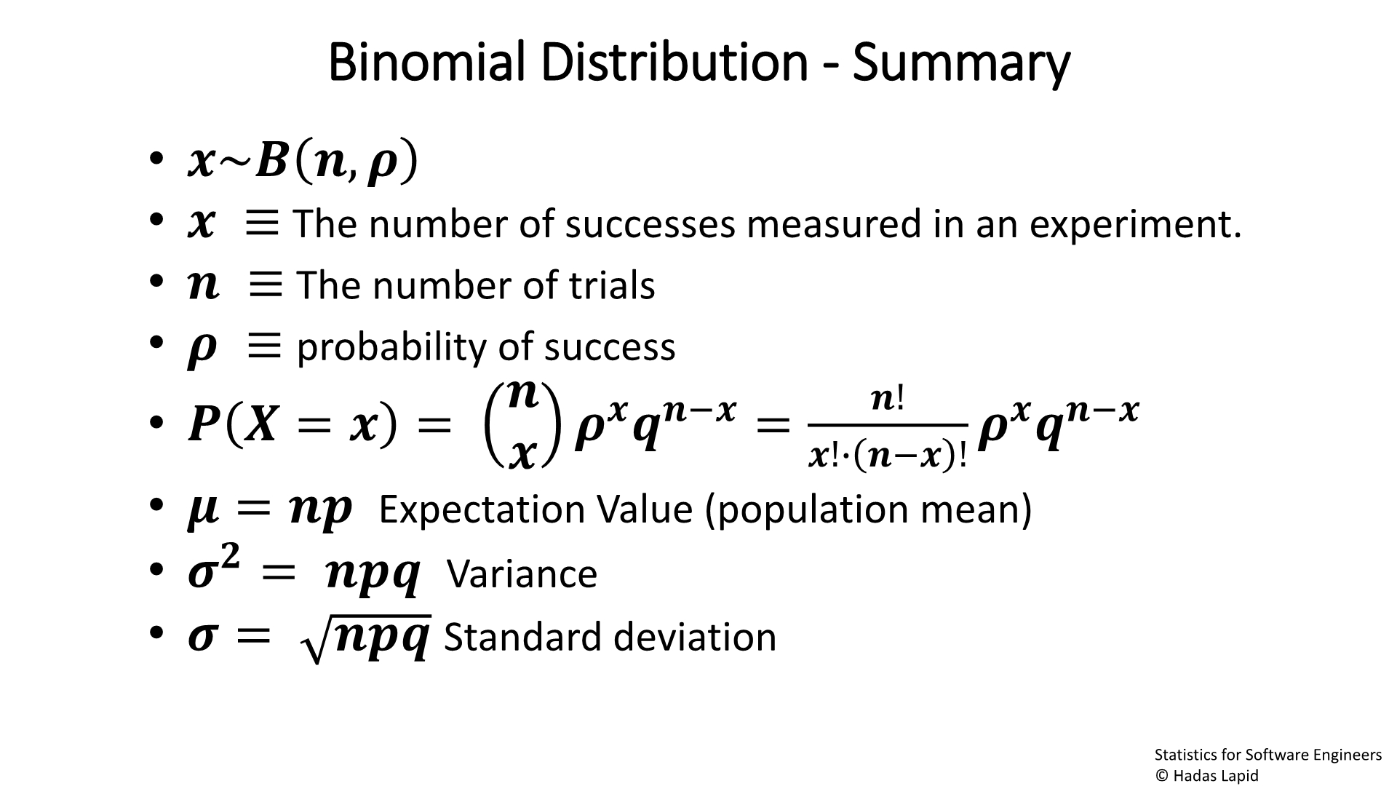



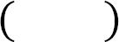
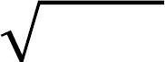
Binomial Distribution - Summary
• ഥ~ഥ ഥ,ഥ
• ഥ ≡
• ഥ ≡
•
The number of successes measured in an experiment.
The number of trials
ഥ ≡ probability of success
ഥ
ഥ!
ഥ ഥ = ഥ = ഥ^{ഥ}ഥ^{ഥ−ഥ} =
ഥ^{ഥ}ഥ^{ഥ−ഥ}
•
ഥ
ഥ!∙ ഥ−ഥ !
• ഥ = ഥഥ
Expectation Value (population mean)
• ഥ^{ഥ} = ഥഥഥ
• ഥ = ഥഥഥ
Variance
Standard deviation
Statistics for Software Engineers
© Hadas Lapid
Notes:
Mean and Variance of Binomial Random Variables
http://www.math.ubc.ca/~feldman/m302/binomial.pdf
ממוצע ההתפלגות ההצלחות תלוי במכפלה של מספר הניסויים ואחוז הצלחת ניסוי בודד
ווריאנס ההתפלגות תלויה

Slide 16
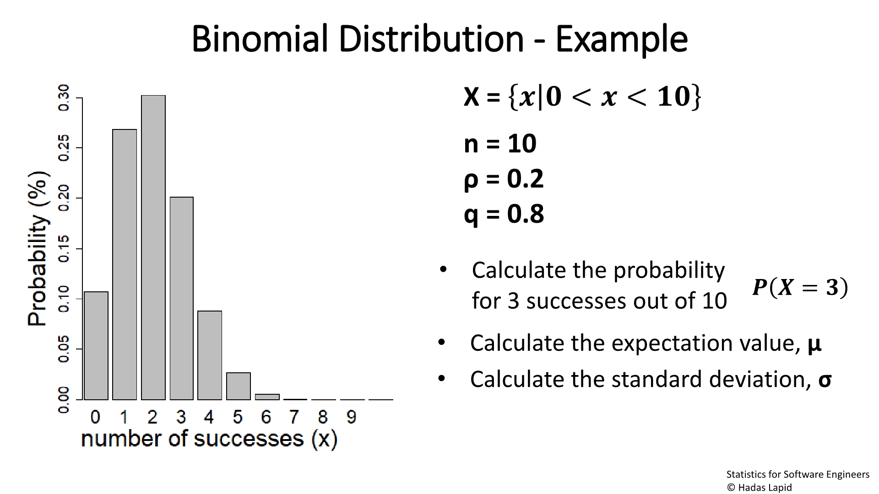
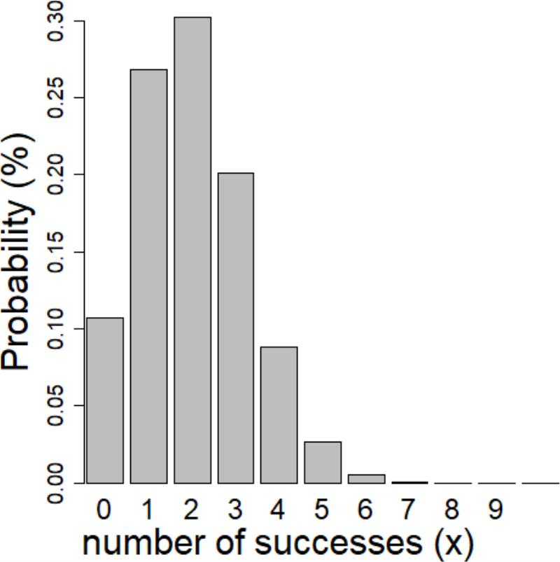
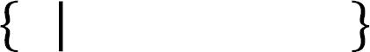
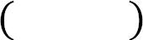
Binomial Distribution - Example
X = ഥ ഥ < ഥ < ഥഥ
n = 10
ρ = 0.2
q = 0.8
• Calculate the probability
ഥ ഥ = ഥ
for 3 successes out of 10
• Calculate the expectation value, μ
• Calculate the standard deviation, σ
Statistics for Software Engineers
© Hadas Lapid
Notes:
Mue = n*p = 2
Sigma = srr(n*p*Q) = sqr(10*0.2*0.8) = sqr(1.6) = 1.265
Binomial Distribution
https://demonstrations.wolfram.com/BinomialDistribution/

Slide 17
Poisson Distribution
• Discrete probability distribution that describes the
probability of a given number of events occurring in a
fixed interval of space or time
• Examples:
- # of calls to an emergency service per hour
- # of traffic accidents in a given street per week
- # of incoming text messages per day
- # of laser photons hitting a detector in a particular time interval
Statistics for Software Engineers
© Hadas Lapid
Notes:
Poisson distribution
https://en.wikipedia.org/wiki/Poisson_distribution

Slide 18
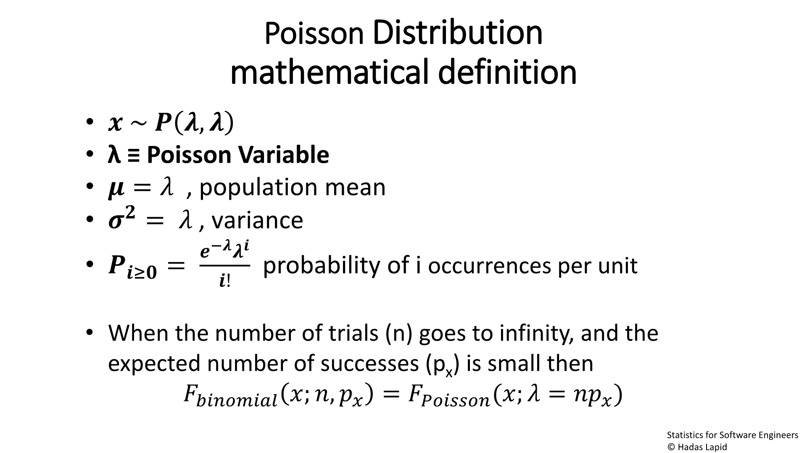

PoissonDistribution
mathematical definition
• ഥ ~ ഥ,ഥ
• λ ≡ Poisson Variable
• ഥ = ഥ , population mean
• ഥ^{ഥ} = ഥ , variance
−ഥ
ഥ
• ≥
=
ഥ ഥ
probability of i
occurrences per unit
ഥ!
• When the number of trials (n) goes to infinity, and the
Statistics for Software Engineers
© Hadas Lapid
Notes:
Deriving the Poisson Distribution from the Binomial distribution
https://medium.com/@andrew.chamberlain/deriving-the-poisson-distribution-from-the-binomial-distribution-840cc1668239
At first glance, the binomial distribution and the Poisson distribution seem unrelated. But a closer look reveals a pretty interesting relationship.
It turns out the Poisson distribution is just a special case of the binomial
— where N, the number of trials is large
and the probability of success in any given one is small.
N → infinity
P → 0

Slide 19
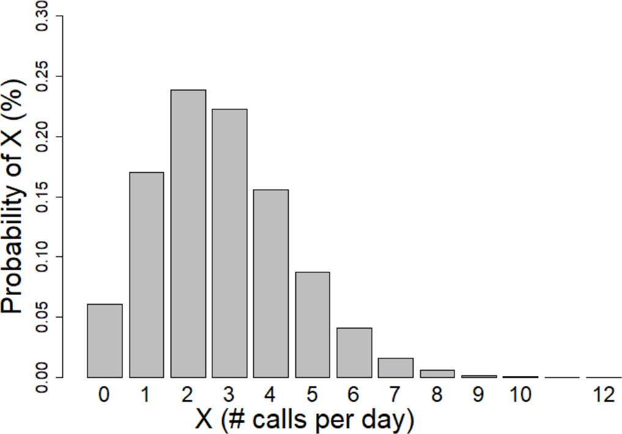
Poisson Distribution
with Poisson variable λ=2.8
Mean: λ=2.8
Variance: λ=2.8
Statistics for Software Engineers
© Hadas Lapid

Slide 20
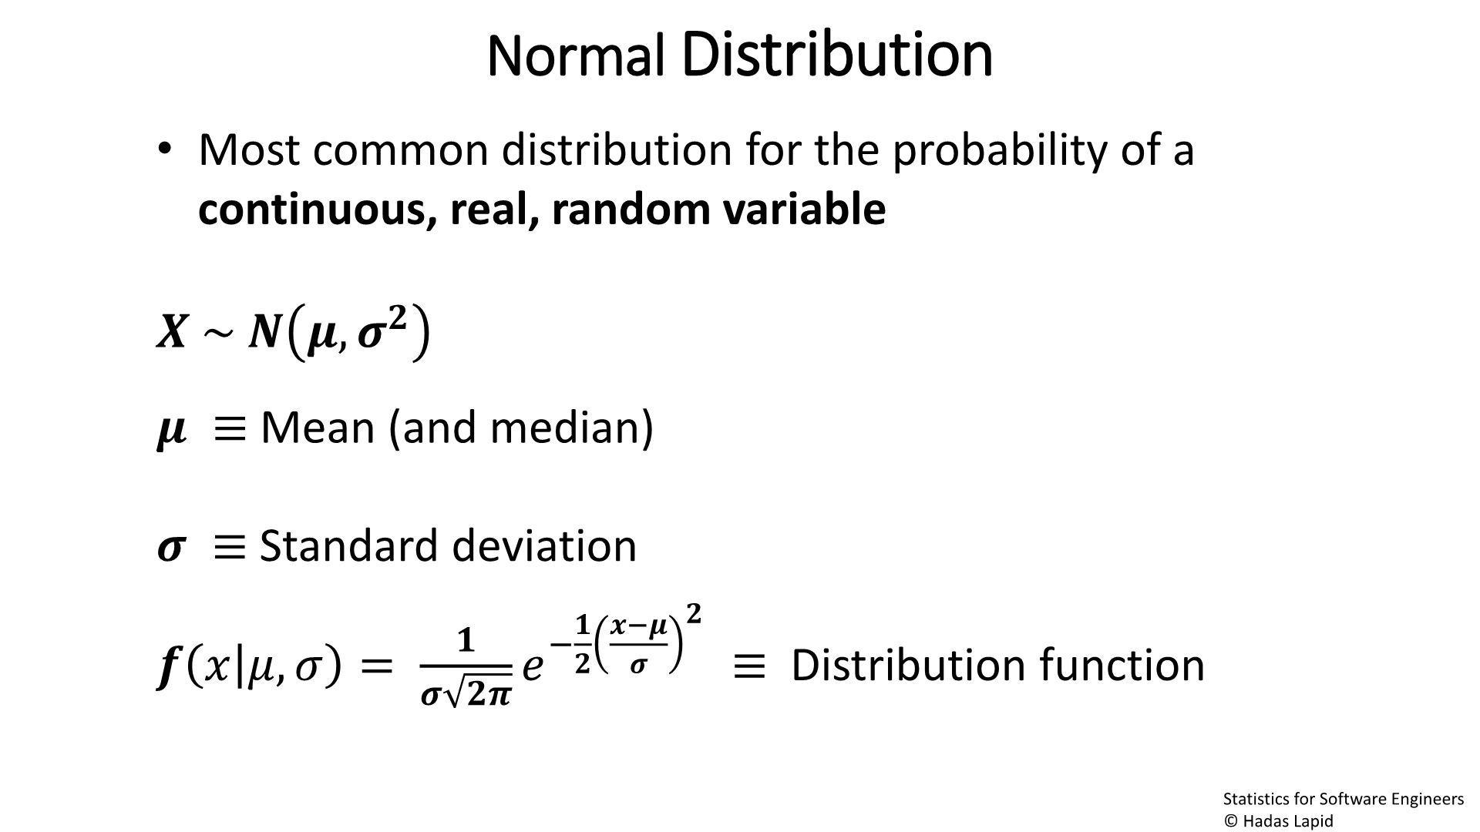

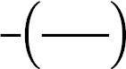

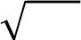
NormalDistribution
• Most common distribution for the probability of a
continuous, real, random variable
ഥ ~ ഥ ഥ,ഥ^{ഥ}
ഥ ≡ Mean (and median)
ഥ ≡ Standard deviation
ഥ
₋ഥ
ഥ−ഥ
ഥ
ഥ
ഥ
ഥȁഥ,ഥ
=
ഥ
≡ Distribution function
ഥ
ഥ
ഥഥ
Statistics for Software Engineers
© Hadas Lapid
Notes:
A Derivation of the Normal Distribution
https://web.sonoma.edu/users/w/wilsonst/papers/Normal/default.html
Definition: Data are said to be normally distributed if the rate at which the frequencies fall off is proportional to the distance of the score from the mean, and to the frequencies themselves.
we need a formula for the curve. We can find such a formula because our definition gives us the following differential equation.
Df/dx = -k*(x-mue)*f(x)
Df/f = -k*(x-mue)*dx
Integral(Df/f) = -k*Integral((x-mue)*dx)
f(x) = C*exp(-k/2*(x-mue)^2)

Slide 21
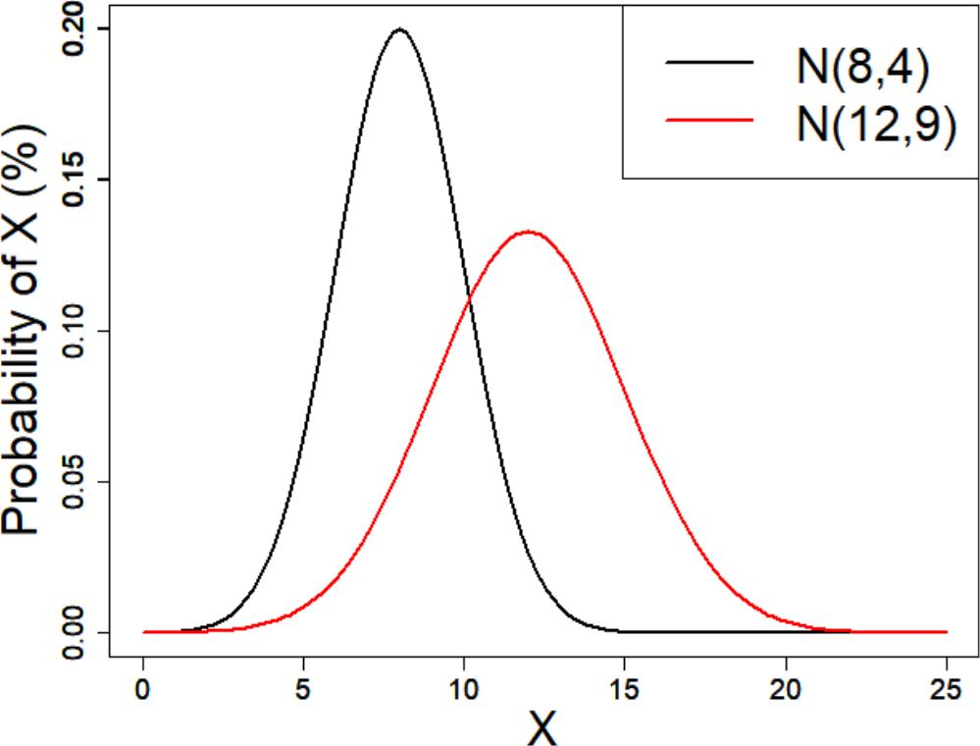
Normal Distribution
Statistics for Software Engineers
© Hadas Lapid

Slide 22
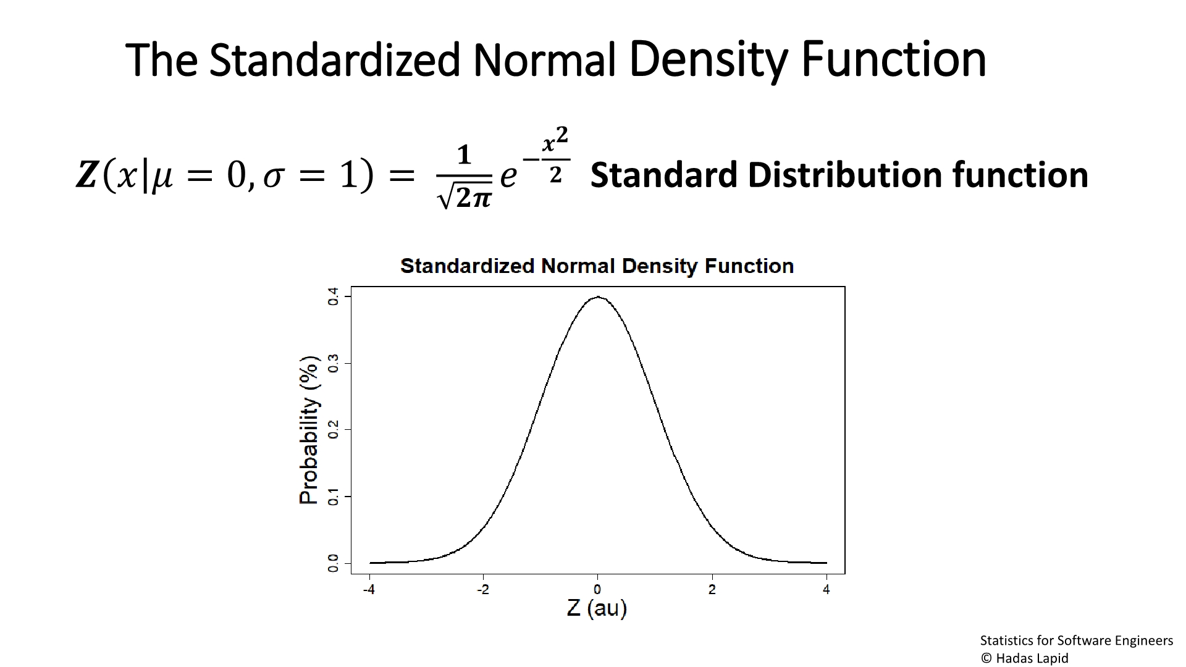


The Standardized NormalDensity Function
ഥ
ഥ −^{ഥ}
ഥഥ
ഥ ഥȁഥ = 0,ഥ = 1 =
Standard Distribution function
ഥ
Statistics for Software Engineers
© Hadas Lapid
Notes:
לפילוג הנורמלי הרבה צורות בהתאם לפרמטרים שלו
אבל התצורה הסטנדרטית היא עם Mue = 0, S = 1
Z = ((x - Mue) / S)^2 = x^2
Standard Normal Distribution and Standard Scores
As we’ve seen above, the normal distribution has many different shapes depending on the parameter values. However, the standard normal distribution is a special case of the normal distribution where the mean is zero and the standard deviation is 1. This distribution is also known as the Z-distribution.
A value on the standard normal distribution is known as a standard score or a Z-score. A standard score represents the number of standard deviations above or below the mean that a specific observation falls. For example, a standard score of 1.5 indicates that the observation is 1.5 standard deviations above the mean. On the other hand, a negative score represents a value below the average. The mean has a Z-score of 0.

Slide 23
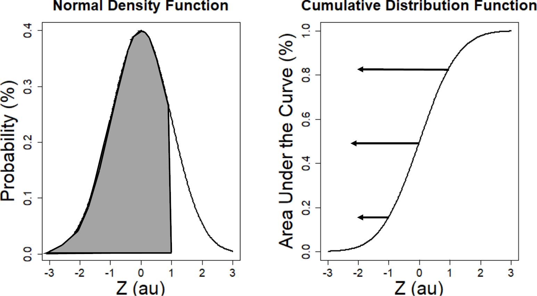
0.84
0.5
0.84
0.5
0.16
0.16
Statistics for Software Engineers
© Hadas Lapid
Notes:
Cumulative distribution function - Wikipedia
אין משמעות להסתברות בנקודה מסויימת (אלא רק באינטרוול)
לכל פילוג הסתברות של משתנא אקראי רציף היא פילוג צפיפות הסברות
df/dx
פונקציית פילוג מצטברת נותנת את ההסתברות של מקרה X ממינוס אינסוף עד X.

Slide 24

Why is the "Normal Distribution" important?
• The distribution of many continuous observables in nature
is approximately normal
• We can describe the normal distribution in an equation
We can draw conclusions about the relations between
variables with Magnitude and Significance estimates
Statistics for Software Engineers
© Hadas Lapid
Notes:
Ever Wondered Why Normal Distribution Is So Important?
Normal distribution (also gaussian distribution) is extremely simple
הרבה תופעות בטבע מפולגות נורמלית
גם תופעות שלא מפולגות נרמלי, הן בעלות פילוג נורמלי של השגיאה של ממוצעי המדגם שלהן
מתמטיקה פשוטה עבור רגרסיה ואלגוריתמים שונים.
פילוג שמאפשר הסקה סטטסטית נוחה עם הערכות גודל ומשמעות
Occam Razor
https://en.wikipedia.org/wiki/Occam%27s_razor
law of parsimony
"the simplest explanation is most likely the right one"
Other Reasons Why the Normal Distribution is Important
In addition to all of the above, there are several other reasons why the normal distribution is crucial in statistics.
Some statistical hypothesis tests assume that the data follow a normal distribution. However, as I explain in my post about parametric and nonparametric tests, there’s more to it than only whether the data are normally distributed.
Linear and nonlinear regression both assume that the residuals follow a normal distribution. Learn more in my post about assessing residual plots.
The central limit theorem states that as the sample size increases, the sampling distribution of the mean follows a normal distribution even when the underlying distribution of the original variable is non-normal.

Slide 25
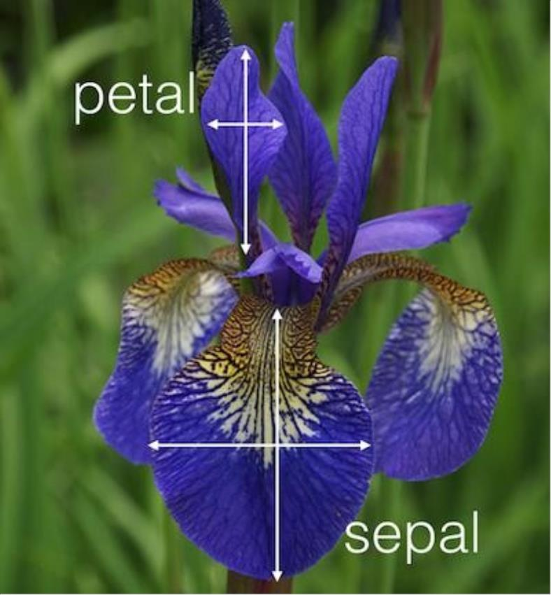
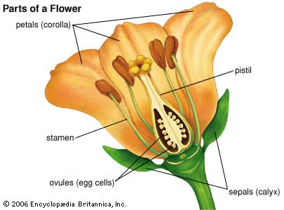
The Iris dataset
Statistics for Software Engineers
© Hadas Lapid
Notes:
עלי כותרת - Petal
עלי גביע - Sepal
https://en.wikipedia.org/wiki/Iris_flower_data_set
The Iris flower data set or Fisher's Iris data set is a multivariate data set introduced by the British statistician, eugenicist, and biologist Ronald Fisher in his 1936 paper The use of multiple measurements in taxonomic problems as an example of linear discriminant analysis.^{[1]}
Data set[edit]
Iris setosa
The dataset contains a set of 150 records under five attributes –
עלה כותרת petal length,
petal width and
species.
sepal length,
עלה גביע sepal width,

Slide 26
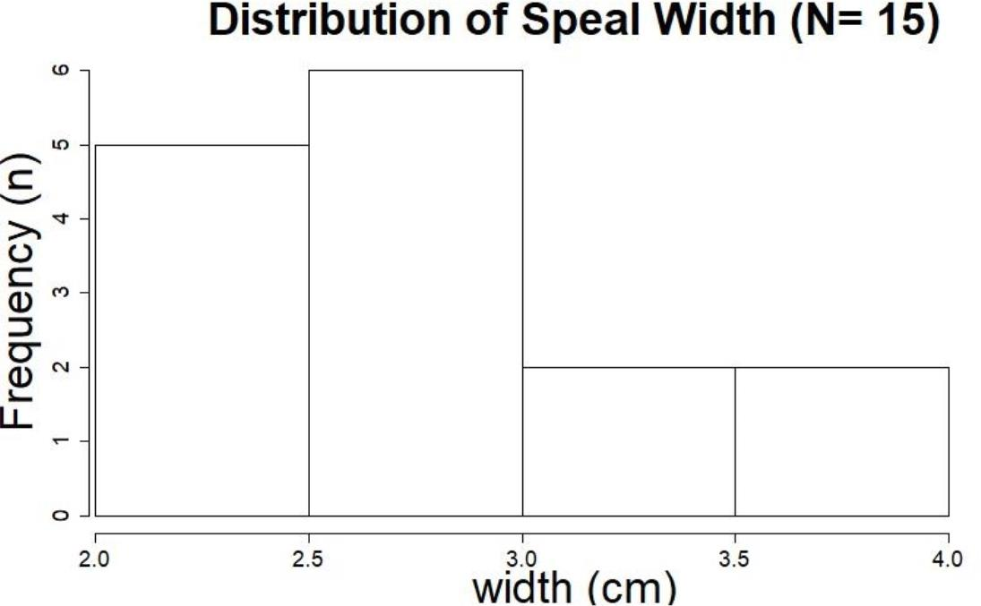
The importance of sample size
Statistics for Software
Engineers
Notes:
Sampling Distributions 4.12 190

Slide 27
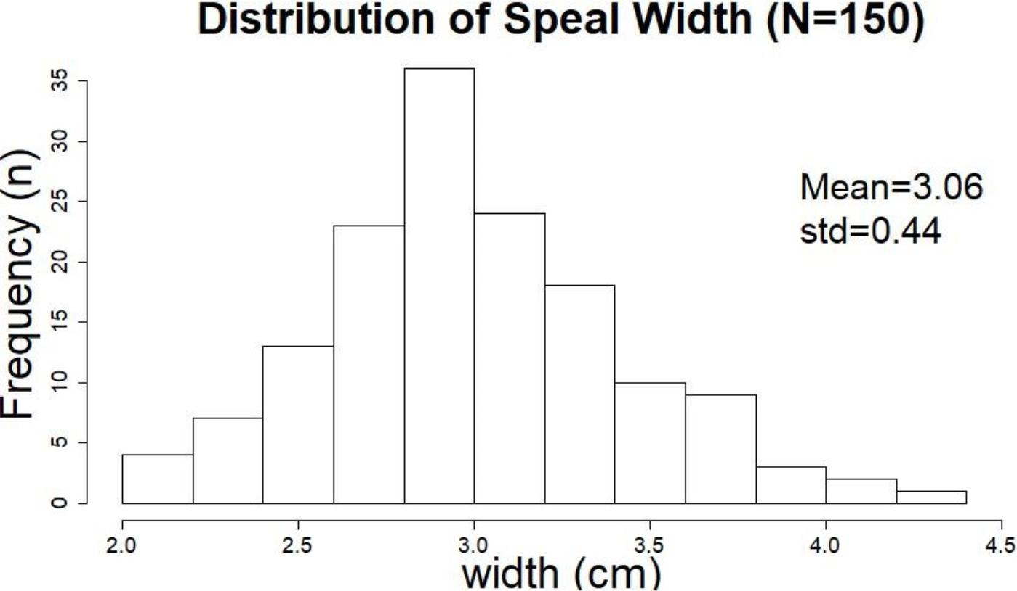
Statistics for Software Engineers
© Hadas Lapid
Notes:
פילוג עלי גביע – נורמלי בקירוב

Slide 28

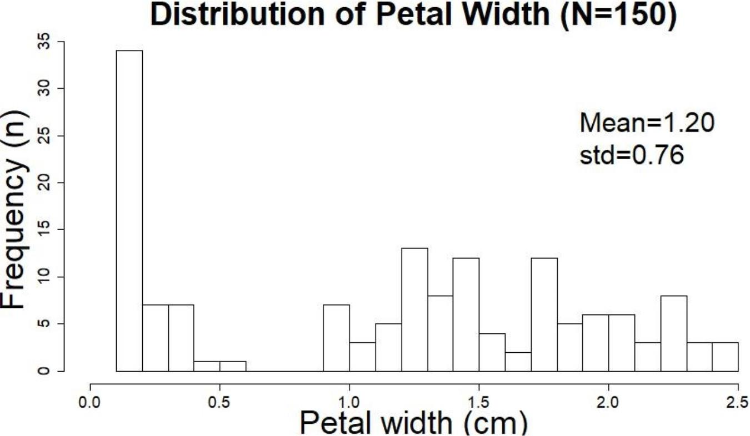
Conclusion:
NOT ALL CONTINUOUS VARIABLES ARE NORMALLY DISTRIBUTTED
Statistics for Software Engineers
© Hadas Lapid
Notes:
פילוג עלי כותרת אקראי (מולטי מודלי)
רוב התהליכים בטבע גאוסיים
אבל יש חלק עם פילוג שונה, למשל:
פילוג שטוח (הטלת קוביה)
ראלי,
פואסון (פליטה פוטונית, זנב לא סימטרי..)
דו-שיאי (אלקטרון, יכול להימצא ב 2 מצבים) ועוד.

Slide 29
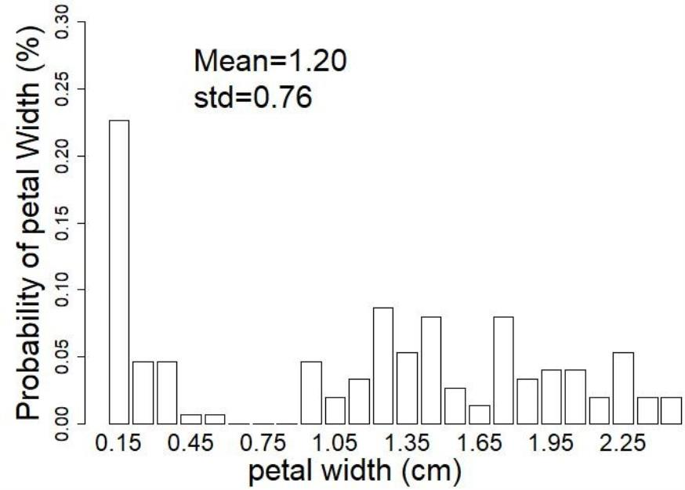
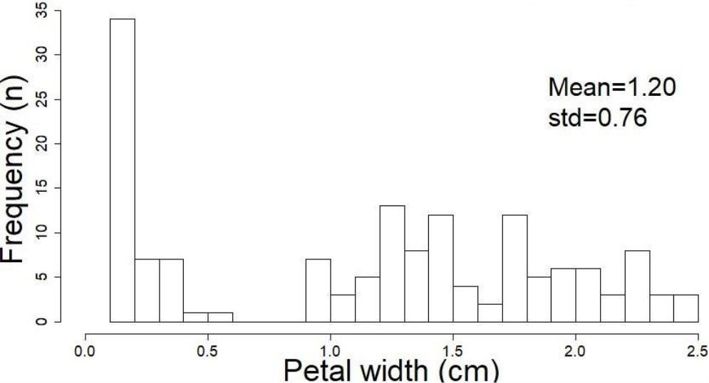
Frequency vs. Probability Distributions
Probability Distributions
Frequency Distributions
# frequency of counts per bin
# counts per bin
Statistics for Software Engineers
© Hadas Lapid
Notes:
הסטוגרמה
סטטיסטיקה תיאורית – מתארת את המדגם שנלקח
הסקה סטטיסטית – מתארת את האוכלוסייה (ממוצע ושונות) מתוך המדגם שנלקח

Slide 30
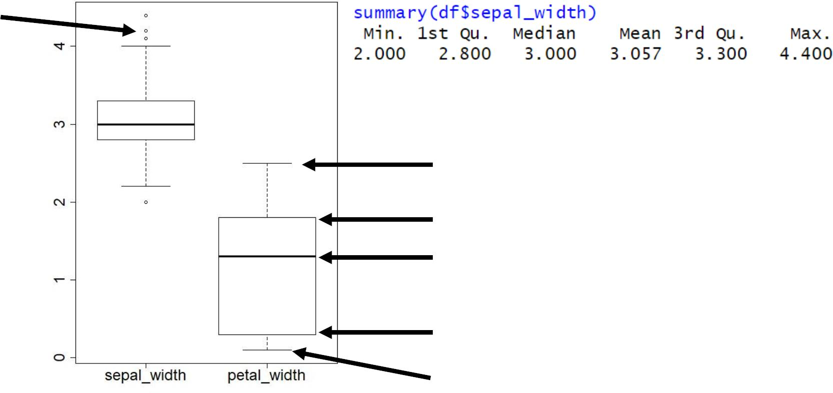
Boxplots and quantiles
outliers
maximum
75% quantile
Median
25% quantile
minimum
Statistics for Software Engineers
© Hadas Lapid
Notes:
הצגת ממצאי הדגימה הסטטיסטית
הסטוגרמה
תרשימי קופסה
גרף
הסקה סטטיסטית על האוכלוסייה ממנה לקחנו את המדגם
חישוב סטטיסטיקה (ממוצע וסטיית תקן) של האוכלוסייה
חישוב שגיאת הערכת הסטטיסטיקה (שגיאת הממוצע)
השערה סטטיסטית ומרווח ביטחון שלה

Slide 31
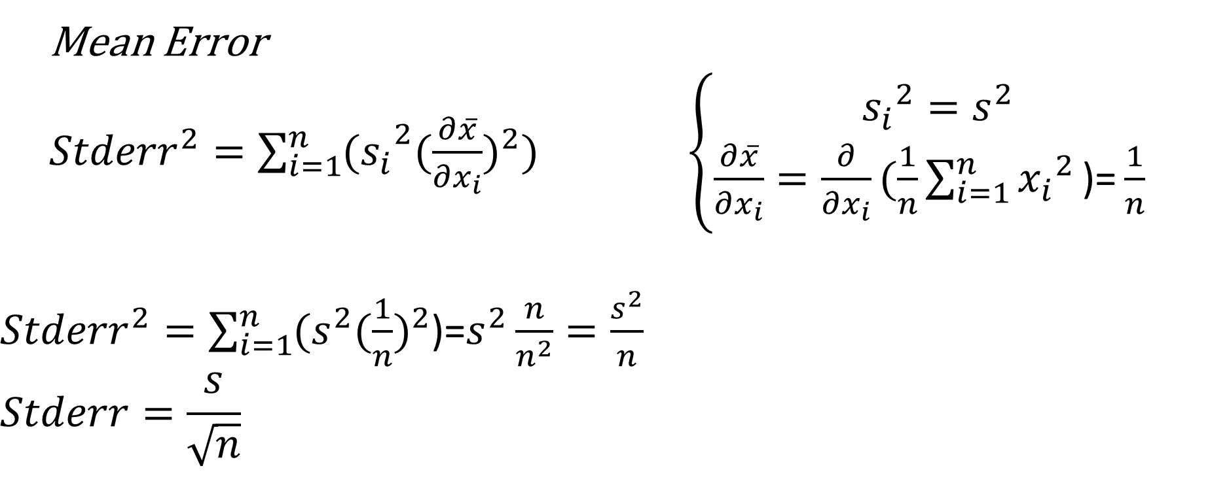
Basic Concepts
Mean Error
${Stderr}^{2}=\sum_{i=1}^{n}{{(s_{i}}^{2}{(\frac{∂\overline{x}}{∂x_{i}})}^{2}})$ $\left\{\begin{matrix}{s_{i}}^{2}=s^{2} \\ \frac{∂\overline{x}}{∂x_{i}}=\frac{∂}{∂x_{i}}(\frac{1}{n}\sum_{i=1}^{n}{{x_{i}}^{2}}\text{)=}\frac{1}{n} \end{matrix}\right.$
${Stderr}^{2}=\sum_{i=1}^{n}{(s^{2}{(\frac{1}{n})}^{2}}$)=$s^{2}\frac{n}{n^{2}}=\frac{s^{2}}{n}$
$$Stderr=\frac{s}{\sqrt{n}}$$

